Slide 1
Career Planning
A step by step approach

Slide 2
Career
Career is an occupation or a profession, that one undertakes for a long period of their lifetime & derives monetary benefit from it.
Example:
If someone is painting pictures for a long time, but does not expect to gain any monetary reward, that will be considered as their hobby rather than career.
Similarly if the person paints & exhibits the paintings in a gallery for prospective buyers, then painting will be considered as their profession.

Slide 3

Career Planning
It is not about deciding at the age of 16 or 18 or 21 what you want to do for the rest of your life. It is about uncovering ever more possibilities and using robust planning, research and evaluation techniques to make these possibilities tangible and real.
If knowledge is power, but you have ‘no idea’ what you want to do with your future, you are powerless

Slide 4
Know what you want Life values
Definition
Life values are enduring beliefs that a certain way of behaving or certain life goals are personally or socially preferable to you.
Importance
Life values are the basis for judging the appropriateness of your behavior in the present. They also provide you a sense of what goals are appropriate.

Slide 5
Know what you are
An individual having a set of qualities and abilities that interacts in its environment in a unique way.
Assess the following skills
Technical knowledge
Aptitudes and abilities
Personal characteristics
Identify your fields of interest

Slide 6
What Employers Look For?
Transferable skills
Communication
Team work
Leadership
Initiative
Problem solving
Numeracy
Interpersonal
Self awareness
Flexibility and adaptability
Commitment and motivation

Slide 7
Need of Career Planning
We live in a competitive world, which follows the policy of Survival of the fittest ‘The Law of The Jungle’, where those who are weak are crushed by the mighty.
Career Planning is a tool that makes a person Competitive.

Slide 8
Importance of CareerPlanning
Second chances are very rare so we have to capitalize on the opportunity available to us
If You Don’t Plan You Don’t Succeed

Slide 9
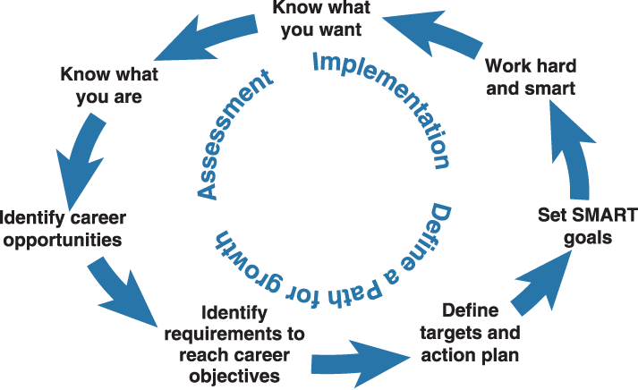
Career Planning Cycle

Slide 10
Identify career opportunities
Explore the jobs available in your field of interest
Note the possible progression paths for this given profession
Identify the next job you will need to go for to reach the ultimate job

Slide 11

The 3-Step Approach
Step one: Look to the future and identify long term career goal.
Step two: Research courses/jobs/business opportunities which can lead to that career.
Step three: Plan how you will achieve the first step of your ladder.

Slide 12
Looking at job families…
Programming
Computer Systems
Sales/Services
Economic/Statistical
Services
Management Services
Computer Operations
Technical Authorship
Database Administrator
Many Associated Jobs
Information Systems Manager

Slide 13
Identifying the requirements and setting actions
Example HR Associate– recruitment
Skills Needed | Experience or Action Required
Interviewing skills | Mock interviews (University Projects) Internship as HR Assistant
Knowledge of assessment tests | Masters degree in Industrial Psychology
Ability to administer tests | Vendor certification or Masters in Industrial Psychology

Slide 14
Career Planning Process
Career planning process is simple process of self analysing, self upgrading & self improvement. Which leads you toward .
There are five steps to active career planning:
Self Assessment
Exploration and Research
Decision Making
Taking Action
Evaluation

Slide 15
Self Assessment
Self assessment revolves around the thoughtful consideration, reflection, and evaluation of your interests, personality characteristics, values, and skills through a variety of methods, such as the use of a whole host of career-related tools and instruments.

Slide 16
Exploration and Research
The career planning component consisting of exploration and research is all about being in information gathering mode. This is the time to explore, collect, and organize all available resources to eventually begin analyzing them to see what top options arise.

Slide 17
Decision Making
The decision-making step of the career planning process is when you put all the pieces of information about yourself and your carefully collected career information together as best as possible to produce a list of career-related SMART goals and options.
Specific
Measurable
Attainable
Realistic
Timebound

Slide 18
Taking Action
Taking action is one of those things that’s easier said than done. This stage is about literally being proactive with your career plans and following through with what you’ve decided on doing.

Slide 19

Traffic Light Colour Code
Taking Action
Red for ‘I have not made any progress with this yet ‘
Orange for ‘I have identified this target but still some way to go ‘
Green for ‘I have made good progress and completed this target’

Slide 20
Evaluation
After you have made your career-related decision(s) and identified your goals, keep in mind that many of the folks who achieve career success are the ones who continually evaluate and assess their status. They keep track of their career progress throughout their lifetime.

Slide 21
Tips for building a Career
Realize your goals
Never Stop Learning
Ask, Listen And Learn
Fulfil Your Current Job
Build Your Network
Prepare Yourself

Slide 22
Benefits of Career Planning
An individual conducts a research & the results lead to an increased awareness in the field of interest
Strives day & night to achieve their vision
More Chances of becoming a dignified & a respected professional
Less chances of becoming the ‘Rotten Tomato’

Slide 23
Myths
Choosing a career is simple
A career counselor can tell me what occupation to pick
Once I choose a career Ill be stuck in it forever
If my best friend (or brother, uncle, or neighbor) is happy in a particular field, I will be too

Slide 24
Sources of Career Planning
Often students seek out knowledge for Career Planning from various channels. Some of these channels are listed below:
Family & Friends(guidance from Family elders, cousins & good friends)
Changing Market Trends (observation)
Professional Counseling (Teachers, Professors & other various professionals)
Mass Media(Talk Shows, Radio, etc)
Following in the Shoes of Role Models (Influence)

Slide 25
Thank you
Any questions?

